Slide 1
Web Development
Lesson 4:
Getting started with Node.js

Slide 2
Topics
Node Basics and Features
Node Command-Line
Modules
npm

Slide 3
Objectives
By the end of this lesson you should be able to:
Understand the basics of node.js
Interact with node.js on the command line
Understand and use npm

Slide 4
Web App Basics
The basics of web apps
HTTP, HTTPS, SSL, TCP/IP
Client
Server
Web Server
Server-side Web Apps
Client-side Web Apps
Notes:
Notes:
Client == browser
Web server can be Apache, nginx, or similar
In node, we use Node to build servers
Client-side web apps are built with HTML+CSS+JavaScript
Server-side web apps are built with one of the server or back-end technologies

Slide 5
Server-Side Web Apps
Technologies used to build server-side web apps:
Python: Dynamic
C, C++ (CGI): Compiled
PHP: Interpreted
Ruby: Interpreted; often used with Ruby on Rails
Java: Compiled; often used with Spring MVC
Node: Interpreted; often used with Express
Perl: Interpreted
Go: Interpreted
Notes:
Notes:
These are some of the technologies engineers use to build server-side (backend) web apps.
PHP is being one of the most popular for amateurs and hobbyists. WordPress is built on PHP. Early versions of Facebook are built on PHP (now they use C/C++ but with PHP syntax).
Java is one of the most popular choices for enterprise web apps.
Ruby on Rails was popular with startups, but at a large scale it can become slow (Twitter fail whale!)
Node is becoming popular and pushing both PHP and Java away.
References:
Dynamic vs interpreted: http://programmers.stackexchange.com/questions/88645/is-dynamic-language-always-interpreted

Slide 6
Node.js
"Everything is a callback... in Node everything is non-blocking and so it doesn't allow you to just sit there and then return the response. ”
- Ryan Dahl
Notes:
Notes:
Give 3-5 minute overview of Node history: Ryan started Node as an experiment then joined Joyent, where he perfected the platform to ~0.8. Then he left and Joyent took Node to 0.12. The open source community then forked Node into io.js. io.js became Node.js under Node Foundation-part of Linux Foundation with Open Open Source governance instead of benevolent dictatorship for life.
Discuss the basic server in node.js, how the request and response work, what libraries they're from and then dive into code.
References:
http://www.infoq.com/interviews/node-ryan-dahl

Slide 7
Node Benefits
Benefits to developers, devops, users, and managers
Better User Experience
Less $ on servers
Spend less time on development
Spend less $ on developers:
Faster time to market
Easier to attract talent
Write less code
Notes:
Notes:
Better Better User Experience because apps can be faster
Less $ on servers: Non-blocking I/O is more performant meaning you can handle more traffic with the same number of servers or cut your server cost if the traffic remains the same
Write less code: Devs can reuse code from browser and vast ecosystem of Node and JS packages/modules (npm has 2x the number of modules than Maven Central or Ruby Gem)
Spend less time on development: JavaScript/Node is expressive and has little overhead comparing to OOP languages (Java); and also JS is interpreted which dramatically reduces time of iteration (you don’t need to wait to see if your code is working properly)
Spend less $ on developers: If you are manager, or a business owner, you will spend less money of developers because you don’t need a dedicated back end team. Your front-end engineers can work on back-end and vice verca. Therefore, you end up not wasting any cyctles when B.E., team has no work or otherwise.
Faster TTM: Communication overhead slows downs the development, so by having generalist engineers and not separate back-end and front-end teams, you can move faster-there’s less lag, fewer meetings, and less lost knowledge.
JavaScript is the most popular run-time, it’s in every browser. There are a lot of JavaScript developers. It’s easy to train a JavaScript developer in Node.

Slide 8
Node Language and Features
Node is not JavaScript, but both JavaScript and Node are ECMAScript
Features:
Non-blocking I/O
JavaScript/ECMAScript
npm
Notes:
Notes:
Language:
Explain that JavaScript wasn't the first choice for Node. Node is just another implementation of ECMAScript.
Talk about ECMAScript.
There are discrepancies between browser JS and Node such as globals, modules, file system and other things covered in this lesson.
Node features translate into better speed/performance (non-blocking I/O), code&skills reuse (same language!), and vast ecosystem of module (npm).
Explain non-blocking I/O, event loop and V8 modules which facilitate event loop. – This is great for I/O bound systems (no gains for CPU-bound systems)
Explain how, with non-blocking systems, processes don't have to wait for the input/output to finish.
Explain how Node is better at high I/O and low CPU tasks because of the non-blocking I/O.
Contrast non-blocking I/O in Java, Ruby and Python with Node (Node is better because it's simpler).

Slide 9

Non-Blocking I/O
registercallback
Event Loop
(Single Thread)
Intensive
Operation
Requests
File Systems
Database
Computation
Trigger
Callback
Operation Complete
Notes:
Notes:
Node.js allows developers to build non-blocking input/output (I/O) systems
Non-blocking I/O systems are great at handling I/O-bound tasks because those tasks won’t block the system
Non-blocking I/O is not exclusive to Node. Java, Python and Ruby can be use but they require frameworks (more complicated), NIO, Twisted and EventMachine respectively
Examples of I/O tasks are read from a file system, write to a file system, read from a database, write to a database, make an HTTP request to an API/service – they require waiting and in the blocking I/O system this waiting is a waste. Conversely, in non-blocking I/O systems, the waiting is not wasteful because the system can process other requests

Slide 10
ECMAScript
Many flavors of ECMAScript
Mozilla Firefox ECMAScript implementation
Google Chrome ECMAScript implementation
Microsoft Chakra ECMAScript implementation
Safari ECMAScript implementation
Node ECMAScript (Chrome V8 or Chakra engines)
Notes:
Notes:
Node is just one of the implementations of ECMAScript just like we have different ECMAScript in browsers.
Most of the times when people say ECMAScript they mean JavaScript (browser or Node). In some rare cases, they might mean the standard, not the implementation: for example, standard has a feature ES6 modules, but none of the browsers implement it (as of June 2016) while Node has CommonJS standard for modules which is very different from ES6 modules standard.
References:
https://github.com/Microsoft/ChakraCore

Slide 11
global Object
The global object is similar to window object in the browser JavaScript
global.require() === require()
global.process === process
global.console === console
Notes:
Notes:
https://developer.mozilla.org/en-US/docs/Web/API/Window
https://nodejs.org/api/globals.html

Slide 12
process Object
In Node, interaction with the current Node process takes place via the `process` object.
As the `process` object is global, it is accessible from anywhere in the application source code.
Notes:
Notes:
The process object is an instance of EventEmitter (observer pattern) - logic can therefore be applied to the process object via callbacks assigned to specific events.
References:
http://nodejs.org/api/events.html

Slide 13
Environment Variables
Environment variables can be accessed via the `env` attribute:
console.log(process.env);
{ SHELL: '/bin/bash',
USER: 'jordan',
HOME: '/home/jordan',
...
}
Notes:
Notes:
https://nodejs.org/api/process.html

Slide 14
Node REPL Demo
$ node
Notes:
Notes:
Demo how to enter Node REPL/shell
Show global, process, and basic browser JS methods like creating a function, concatenation, math, etc.

Slide 15
Node Eval Demo
NODE_ENV=production node -e "console.log(process.env)"
Notes:
Notes:
Show how to evaluate script, i.e., execute script without having a file or entering a REPL.
In this demo we create an environment variable and display it.

Slide 16
Command-Line Arguments
Shell commands accept arguments to alter their behavior:
$ echo "Hello World!" // "Hello World" is the argument here
Notes:
Notes:
Node makes these arguments accessible via ‘process.argv’; e.g., ‘console.log(process.env)

Slide 17
Command-Line Options
The argv property is an array
The first two elements are ‘node’ and the application’s name:
$ node app.js arg1 arg2 arg3=val3
Inside of the Node code:
process.argv => [
'node', 'app.js', 'arg1',
'arg2', 'arg3=val3'
]
Notes:
Notes:
https://nodejs.org/api/process.html#process_process_argv

Slide 18
Exiting a Process
To exit a process, use the exit function
process.exit()
Exit codes can also be specified:
// this process exits successfully
process.exit(0);
// this process failed
process.exit(1);
// this process failed with a different code
process.exit(127);
Notes:
Notes:
Different failure codes can be used to differentiate types of failure.
Knowing how an application failed allows the developers the means to program an appropriate response.

Slide 19
Child Processes
A child process is a process created by another process.
To have Node applications run other processes, use the child_process module.
The exec function runs a shell command, and invokes a callback with references to the child process' standard output and error.
var cp = require('child_process');
var ps = cp.exec('ps aux', function (err, stdout, stderr) {
console.log('STDOUT: ', stdout); // data written to stdout
console.log('STDERR: ', stderr); // data written to stderr
});
Notes:
Notes:
`stderr` does not always show only errors, as there are programs that use it to output additional data.
References:
http://nodejs.org/api/child_process.html

Slide 20
Exec Callback
The exec callback also provides an error object as its first argument.
This can be analyzed if event process execution fails.
var ps = cp.exec('nonexistant-command', function (err, stdout, stderr) {
if (err) {
// stack trace
console.log(err.stack);
// exit code
console.log(err.code);
}
});
Notes:
References:
http://nodejs.org/api/child_process.html

Slide 21
Spawn a Process
//To access a child process’ streams, use the spawn function
var spawn = require('child_process').spawn;
var echo = spawn('echo', ['Manage child processes in Node']);
var tee = spawn('tee', ['spawn.txt']);
echo.stdout.on('data', function (data) {
tee.stdin.write(data);
});
echo.stderr.on('data', function (data) {
console.log('echo stderr: ' + data);
});
echo.on('close', function (code) {
tee.stdin.end();
});
Notes:
Notes:
`spawn` returns an instance of the `ChildProcess` class.
`ChildProcess` inherits from `EventEmitter` and is a private class.
To write to a spawned process, use its stdin's `write` function.
Close the input stream to allow the spawned process to continue its execution.

Slide 22
Modules in Node
Built-in modules with require are a CommonJS notation.
Node Require Example:
var express = require('express');
var app = express();
Requiring Modules:
Modules can live different places with JavaScript
They can be on local machines, virtual machines, servers, remote URI locations, or really anywhere.
Notes:
Notes:
How modules work:
In a module, there is a global variable ‘require’, that is a function.
The ‘require’ function accepts a module identifier as a string (package/module name, or a path to a file or a folder).
‘require’ returns the exported API of the imported module/package.
‘require’ works synchronously and is cached per process based on the module's resolved name or path.
If the requested module cannot be returned, ‘require’ must throw an error.
In a module, there is a global variable called ‘exports’, that is an object or a function to be exported.
This pattern is recommended and global export/import pattern (e.g., `global.NAME = ...`, popular in browsers for a lack of a better mechanism) is discouraged to avoid name collisions.

Slide 23
Loading Node Modules
These modules can be loaded with module loaders like require or via inversion of control patterns
var filesystem = require('fs'),
databaseConfigs = require('./configs/database.json'),
routes = require('../routes'),
server = require('./boot/server.js')
Notes:
Notes:
A module identifier is a String of terms delimited by forward slashes.
A term must be a camelCase identifier, ".", or "..".
Module identifiers may not have file-name extensions like ".js".
Module identifiers may be relative or top-level (absolute).
A module identifier is relative if the first term is "." or "..".
Top-level (absolute) identifiers are resolved off the conceptual module name space root.
Relative identifiers are resolved relative to the identifier of the module in which ‘require’ is written and called.
A PATH variable may be supported by the module loader for resolving module identifiers.

Slide 24
Node Patterns for Module Exports
module.exports = function(ops) {...}
module.exports = {...}
exports.methodA = function(ops) {...} or module.exports.methodA = function(ops) {...}
exports.obj = {...} or module.exports.obj = {...}
Notes:
Notes:
In module, the interface must be exported.
Static objects (configurations, locales, etc.) or functions (classes, dynamic code, constructor/initializer) can be used.
Use the anti-pattern: `exports = ...`, to create a variable `exports` when nothing is exported.
Use `module.exports = ...` if there is one thing to export in one file, and use `exports.NAME = ...` or `module.exports.NAME = ...` to export many things in one file (e.g., utilities).

Slide 25
Exporting with Functional Pattern in Node
//module.js:
module.exports = function requestClass (options) {
var limit = 100
if (options.type === ’binary') {
limit = 200;
}
return {
name: 'request',
limit: limit,
type: options.type,
makeGetRequest: function(data) { return data; }
};
};
//Code outside!
Notes:
Notes:
Functional pattern vs. object:
Provides constructor/init function - more versatile because it can execute code.
Code outside will be executed just once when this module is imported.
If this module is imported again in the same process (could be different file) using exactly the same name, it won't be executed because modules are cached.
On the other hand, if everything exported in `module` won't be implicitly executed, the function must be invoked explicitly in the file, which imports the module (`main.js`—next slide).

Slide 26
Importing with Functional Pattern in Node
//main.js:
var requestClass = require('./module.js');
var request = requestClass({ // Instantiate!
type: 'binary'
});
console.log(request.limit) // 200
console.log(request.makeGetRequest({
url: 'http://webapplog.com'
})); // {url: 'http://webapplog.com'}
Notes:
Notes:
Basic premise:
What is exported is what gets imported.
If a function is exported, then it must be invoked to get an object.

Slide 27
Demo
code/lesson2/modules-basic.js
code/lesson2/increment.js
code/lesson2/math.js
Monolithic app:
modules-step1.js
Modularized app:
modules-step2.js
greetings.js
Notes:
Notes:
Walk through the code explaining how it works.
Explain first the Monolithic app, then the modularized version.

Slide 28
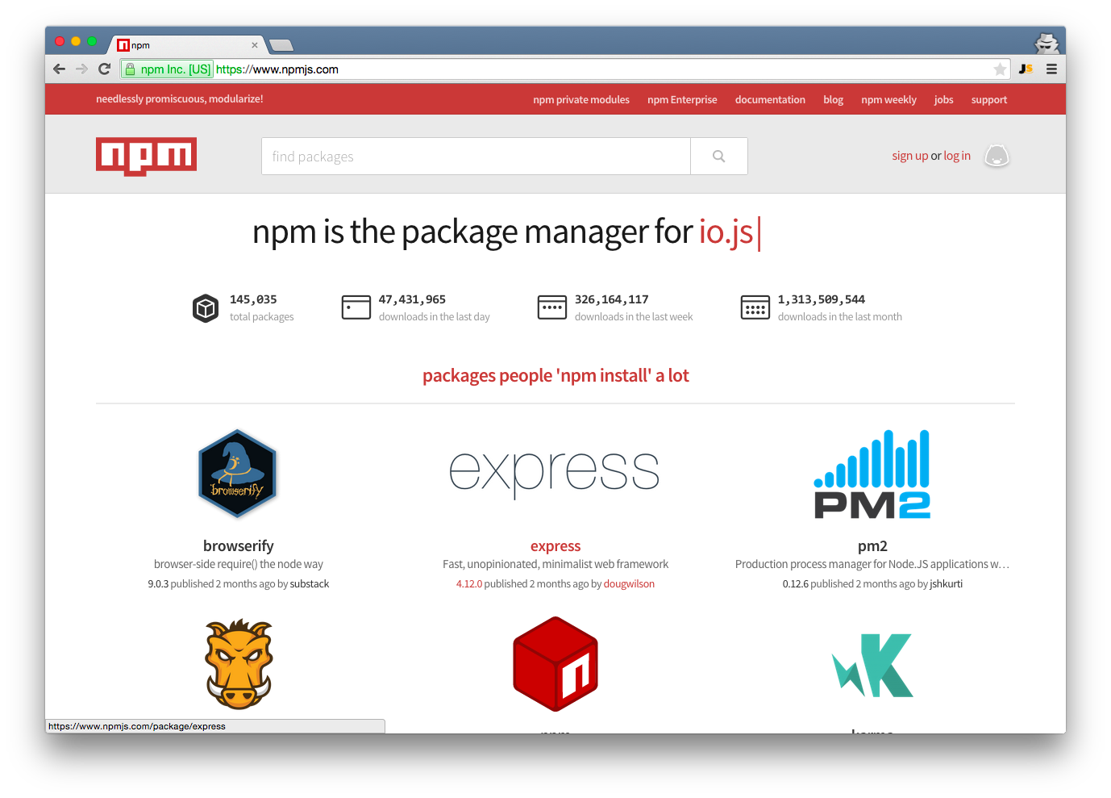
Meet the beast!
Notes:
Notes:
Say how npm is crucial for node, browser JS, and open source.
Explain how it has 2x more modules than maven central (Java) or ruby gem (Ruby).
Get people excited about npm as it's one of the reasons Node became so popular.
There were no solid one-stop repositories and package managers in JS before npm.
Most other languages didn't have them either until recently (e.g., PHP).
Talk about the Node philosophy to keep the core small and let developers decide what packages they want to use (freedom to choose).

Slide 29
What is npm?
A package manager for node
Website: https://www.npmjs.com/
Command-line tool: ‘npm’
Registries: public and private
Notes:
Notes:
Managing dependencies/modules is HARD!

Slide 30
Introduction to npm
Two ways to install a module:
Locally: most of your projects' dependencies, e.g., express, request, hapi
npm install module-name
Globally: command-line tools only (mostly), e.g., mocha, grunt, slc
npm install -g module-name
Notes:
Notes:
Some frameworks offer CLI, but most of them mainly belong into one category (don't try to install `express` with `-g`!)
node_modules is your friend—There are no conflicts unlike Ruby, Python, etc. because each dependency has nested dependencies.

Slide 31
Installing Packages
$ npm install express
$ npm install express@4.2.0
$ npm install express@latest
$ npm install express --save
$ npm install mocha --save-dev
$ npm install grunt -g
$ sudo npm install grunt -g
Notes:
Notes:
Ways to install locally
--save (and --save-dev) saves into package.json
Discuss semantic versioning!

Slide 32
Packaging
Module packaging in Node is done using a `package.json` file
There are many options that can be configured:
Name
Version number
Dependencies
etc
Notes:
Notes:
package.json is a project metadata file

Slide 33
Package.json
//Creating package.json: run init action, interactively creates
$ npm init
This utility will walk you through creating a package.json
file. It only covers the most common items, and tries to
guess sane defaults.
See npm help json for definitive documentation on these
fields and exactly what they do.
Use npm install <pkg> --save afterwards to install a package
and save it as a dependency in the package.json file
Press ^C at any time to quit
name: (my-package-name)

Slide 34
Package.json
{
"name": "my-cool-app",
"version": "0.1.0",
"description": "A gret new application",
"main": "server.js",
"dependencies": {
"express": "~4.2.0",
"ws": "~0.4.25"
},
"devDependencies": {
"grunt": "~0.4.0"
}
Notes:
Notes:
Package.json is required for npm modules and highly recommended for Node projects!

Slide 35
npm
npm install NAME
node_modules directory or package.json in current directory?
Yes
No
Install
Up the tree
Notes:
Notes:
When running ‘npm install NAME’ in a folder:
npm looks for node_modules directory or package.json
If nothing is found it goes up the tree
Therefore, in an empty folder, create package.json or node_modules directory first.

Slide 36
JS in Web Development
JavaScript is language of the web and with Node you can use it on the server as well. This eliminates context switch and give you very fast I/O platform.

Slide 37
Summary
In this lesson, you have learned about
Node language and features
Node command line
Processes
Modules
npm
Package.json
Notes:
Notes:
The Module 2 Lesson 2 Lab should be competed at this time
https://github.com/MSFTImagine/computerscience/blob/master/Complimentary%20Course%20Content/Module2/Labs/Module%202%20Lesson%202%20Lab.docx
Resources:
http://webapplog.com/you-dont-know-node/
http://webapplog.com/node-patterns-from-callbacks-to-observer/
http://webapplog.com/es6/
https://nodejs.org/en/
http://nodeschool.io/
https://docs.npmjs.com/

